Slide 1
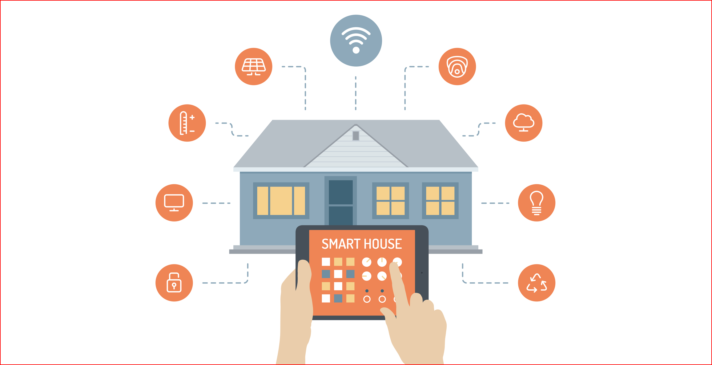
PRESENTATION ON HOME AUTOMATION

Slide 2
CONTENTS:
1. INTRODUCTION 8. WORKING
2. PROJECT MODULES 9. ADVANTAGES
3. BLOCK DIAGRAM 10. APPLICATIONS
4 .COMPONENTS REQUIRED 11. CONCLUSION
5 .WIFI MODULE
6. RELAY
7. MICRO CONTROLLER

Slide 3
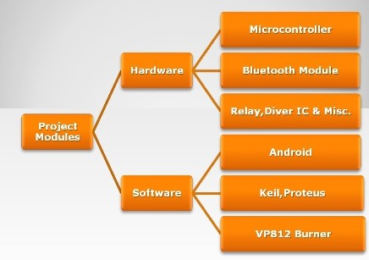
PROJECT MODULE

Slide 4
WHY HOME AUTOMATION ?
It involves degree of computerized or automated control.
It contains remote mobile host controller and several client modules.
The client modules communicate with the wireless device such as Wifi.
In this case we use a smart phone.

Slide 5
LCD
TEMPERATURE SENSOR
SENSOR
ARDUINO BOARD
ULTRASONIC SENSOR
ESP
MOBILE APPLICATION
CLOUD

Slide 6
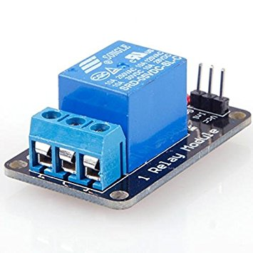
RELAY
It is an electrically operated switch
It is used to control a circuit by a low power signal
It protects circuits from overload

Slide 7
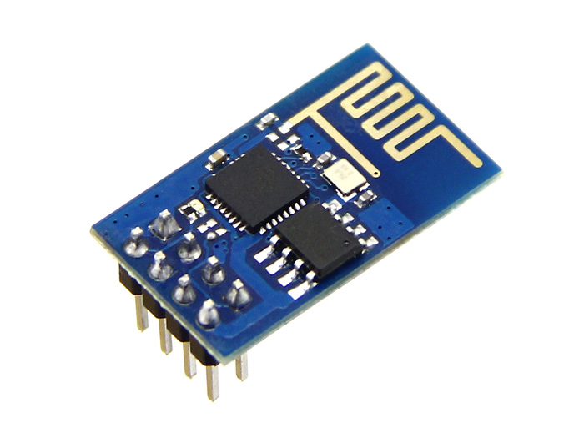
ESP - 8266
It is a low cost Wi-fi microchip
UART dedicated pins
It allows single chip micro controllers

Slide 8
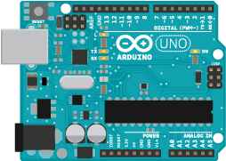
Arduino
It is an open source computer hardware
It manufactures single board micro controllers
The boards are equipped with sets of signals

